Slide 1

Density Based Traffic Signal System using Microcontroller
TEAM-E18
21AIE113-Introduction to Electronics
BL.EN.U4AIE21106 :-Pranave K.C
BL.EN.U4AIE21113:-Sai Subhash M
BL.EN.U4AIE21114 :- Sake Mohith Sai
Presented to Ms. Sudha Yadav
Asst. Professor
EEE Dept
Dept. of EEE ASE, Bengaluru
Slide 1

Slide 2
Contents:
Introduction
Contribution of AI
Objective
Novelty
Literature survey
COMPONENTS used
Software
Circuits:1) software circuit (tinker cad)
2) Hardware circuit
Functional flowchart
Dept. of EEE ASE, Bengaluru
Slide 2

Slide 3
Assembling the circuit
C+:Code
Results
Applications
Potential of this project
Conclusion
References
Dept. of EEE ASE, Bengaluru
Slide 3

Slide 4
INTRODUCION:
It is evident through the roads that the number of vehicles are increasing rapidly.
This results in congested roads that are very hard to manage.
Hard to be punctual , resulting in rash driving, rule breaks and accidents.
Invented signals.
Futile signal.
Dept. of EEE ASE, Bengaluru
Slide 4

Slide 5
CONTRIBUTION OF AI:
Replacing human with that of AI.
Working: 1)Sensing
2)Data Collection
3)Applying logic
4)Output
Reduces mechanical errors
Systematic solution
Dept. of EEE ASE, Bengaluru
Slide 5

Slide 6
OBJECTIVE:
Fix the futile traffic signals
Seamless traffic management
Restore the following rules
Reduce road panic and rash driving
Organised vehicle operation
Dept. of EEE ASE, Bengaluru
Slide 6

Slide 7
NOVELITY:
The existing traffic controller contains complex logic codes
The ultrasonic sensors are more accurate enough to replace normal traffic signal system
LDR sensor detects the light in the surrounding and regulates the lights accordingly
Being fast and smart makes it more efficient and saves time
Slide 7
Dept. of EEE ASE, Bengaluru

Slide 8
LITERATURE SURVEY:
[1]R.Bhargav Devi, E.Sravani,Gaddam Srujan, Shiv Shankar “Density Based Traffic Signal System using Arduino Uno” International Conference on Inventive Computing and Informatics (ICICI) 2020.
This paper discusses about the difficulties faced in regulating the uneven and irregular traffic and proposes a working miniature model to tackle it out .
They have packed the code with basic logics that emphasises operations on the circuit
[2] Zhang Yuye & Yan Weisheng, (2021) “Research of Traffic Signal Light Intelligent Control System Based On Microcontroller”, First International Workshop on Education Technology and Computer Science,pp301- 303.
Describes how the traffic signals could be made to get the maximum efficient useful output.
They have made use of bunch of sensors that are precise with its calculation values
Slide 8
Dept. of EEE ASE, Bengaluru

Slide 9
[3] Kaushik Mandal, Arindam Sen, Abhijnan Chakraborty and Siuli Roy “Road Traffic Congestion Monitoring & measurement using RFDI & GSM Technology” , IEEE/Annual Conference on Intelligent Transportation System, 2020.
They have executed their project with the use of RIDF technology , which uses electromagnetic waves to capture the images could track.
[4]J. Jasmine, Deva Priya, G. Ram Swathi, P. Nathiyar "Intelligent Traffic Control System Using Arduino Uno" IJEAIS Vol. 3 Issue 3, March – 2019, pp. 51-56
Described about how a smart traffic light setup and functions should be.
The codes and logics were of higher tire so it was a bit difficult for us to understand and execute it
Slide 9
Dept. of EEE ASE, Bengaluru

Slide 10
[5] Shilpa S. Chavan, Dr. R. S. Deshpande & J. G. Rana (2019) “Design of Intelligent Traffic Light Controller Using Embedded System” Second International Conference on Emerging Trends in Engineering and Technology, 2019, pp1086- 1091.
The working model contained embedded system that controls two or more computers and made them to execute the logics
[6] V.Jain,A.Sharma, and L.Subramanian. “Road traffic congestion in the developing world”.In ACM DEV, 2020.
The paper talked about the issues on the alarming increase rate of the vehicle numbers and has given the ways through which the issue could be solved
Dept. of EEE ASE, Bengaluru
Slide 10

Slide 11
COMPONENTS USED :
Arduino UNO Microcontroller
Bread boards (2)
Jumper Wires
Ultrasonic Sensors (2)
LEDs-(2-red,2-green,2-yellow,1-orange)
Resistors (8 each of 1KΩ)
Photoresistor
Car models
Slide11
Dept. of EEE ASE, Bengaluru

Slide 12



SOFTWARE:
Arduino IDE
Tinker cad (for software simulation)
Code:
C+-language
Slide 12

Slide 13
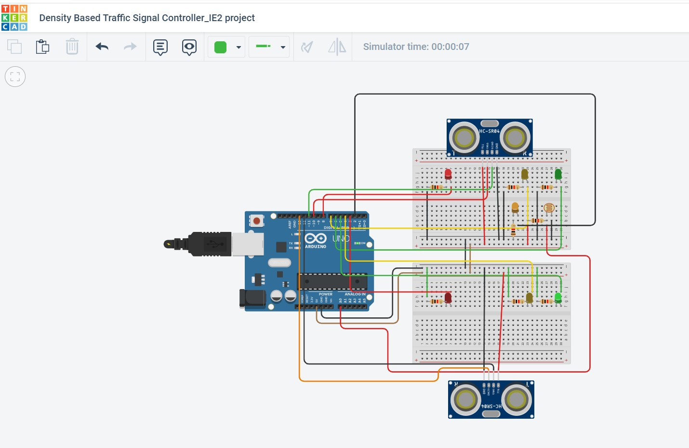
Circuits:
1)SOFTWARE CIRCUIT (tinker cad)
Slide13
Dept. of EEE ASE, Bengaluru

Slide 14
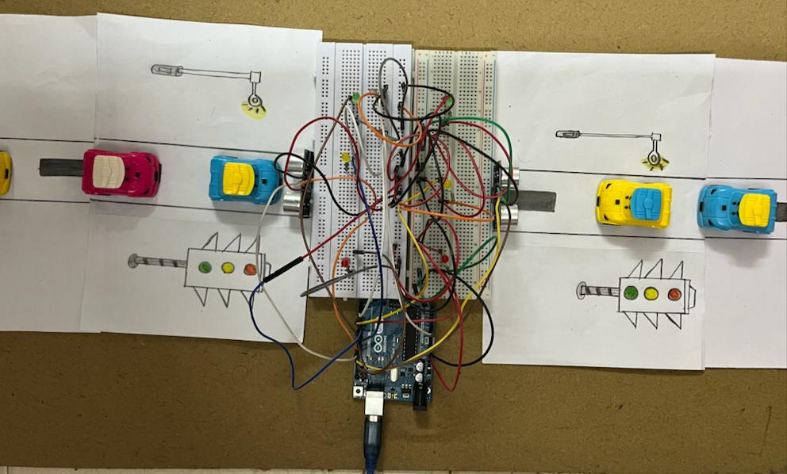
2)HARDWARE CIRCUIT:
Slide 14
Dept. of EEE ASE, Bengaluru

Slide 15
Assembling the circuit:
Connect the 5V power supply and the ground of the Arduino to the positive and the negative terminals of the breadboard
Make sure that the connections are properly grounded
Connect the ground and “Vcc” pins of the ultrasonic sensor(HC-SR04) to their respective terminals
The “Trig” and the “Echo” pins of the ultrasonic sensors are to be connected to any of the Digital pins
Connect the one end of the resistor to the negative of the LED and the positive terminal to the digital pins
Connect one end of the LDR (Light Dependent Resistor) to the resistor and the other end to the analog pin
Slide15
Dept. of EEE ASE, Bengaluru

Slide 16
FUNCTIONAL FLOWCHART:
ULTRASONIC SENSOR
LDR
ARDUINO UNO
LED
TRIG
ECHO
LED
Slide16
Dept. of EEE ASE, Bengaluru

Slide 17
(C+)code:
int red1=8;
int green1=6;
int yellow1=7;
int red2=3;
int green2=5;
int yellow2=4;
int street=2;
const int pingPin1 = 10;
const int pingPin2 = 12;
int echo1=13;
int echo2=11;
long duration;
float duration1;
float duration2;
float distance1;
float distance2;
Slide 17
Dept. of EEE ASE, Bengaluru

Slide 18
void setup() {
pinMode(2, OUTPUT);
pinMode(red1,OUTPUT);
pinMode(red2,OUTPUT);
pinMode(yellow1,OUTPUT);
pinMode(yellow2,OUTPUT);
pinMode(green1,OUTPUT);
pinMode(green2,OUTPUT);
pinMode(echo1,INPUT);
pinMode(echo2,INPUT);
}
void loop() {
int status = analogRead(A0);
Serial.println(status);
int data = map(status,1022,713,255,0);
analogWrite(2,data);
delay(1);
Slide 18
Dept. of EEE ASE, Bengaluru

Slide 19
pinMode(pingPin1, OUTPUT);
digitalWrite(pingPin1,LOW);
delayMicroseconds(2);
digitalWrite(pingPin1,HIGH);
delayMicroseconds(12);
//pinMode(echo1, INPUT);
duration1 = pulseIn(echo2, HIGH);
distance1 = duration1 * 0.034 / 2;
pinMode(pingPin2, OUTPUT);
digitalWrite(pingPin2,LOW);
digitalWrite(pingPin2,HIGH);
delayMicroseconds(12);
//pinMode(pingPin2, INPUT);
duration2 = pulseIn(echo1, HIGH);
distance2 = duration2 * 0.034 / 2;
float d1 = distance1 - distance2;
float d2 = distance2 - distance1;
Dept. of EEE ASE, Bengaluru
Slide19

Slide 20
if(d1 < d2){
digitalWrite(red2,HIGH);
delay(1000);
digitalWrite(green2,LOW);
digitalWrite(red1, LOW);
digitalWrite(yellow1, HIGH);
delay(3000);
digitalWrite(yellow1, LOW);
digitalWrite(green1,HIGH);
delay(7000);
digitalWrite(yellow2,LOW);
}
Dept. of EEE ASE, Bengaluru
Slide 20

Slide 21
if (d2 < d1){
digitalWrite(red1,HIGH);
delay(1000);
digitalWrite(green1,LOW);
digitalWrite(red2, LOW);
digitalWrite(yellow2, HIGH);
delay(3000);
digitalWrite(yellow2, LOW);
digitalWrite(green2,HIGH);
delay(7000);
digitalWrite(yellow2,LOW);
}
}
Dept. of EEE ASE, Bengaluru
Slide21

Slide 22
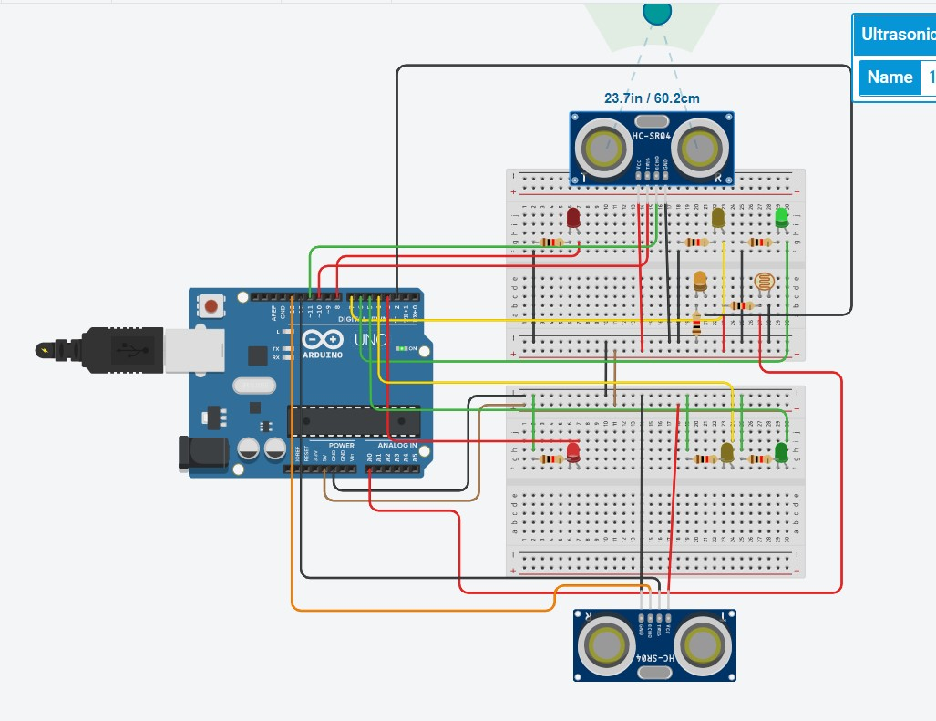
RESULTS:
1) When D1<D2
Dept. of EEE ASE, Bengaluru
Slide22

Slide 23
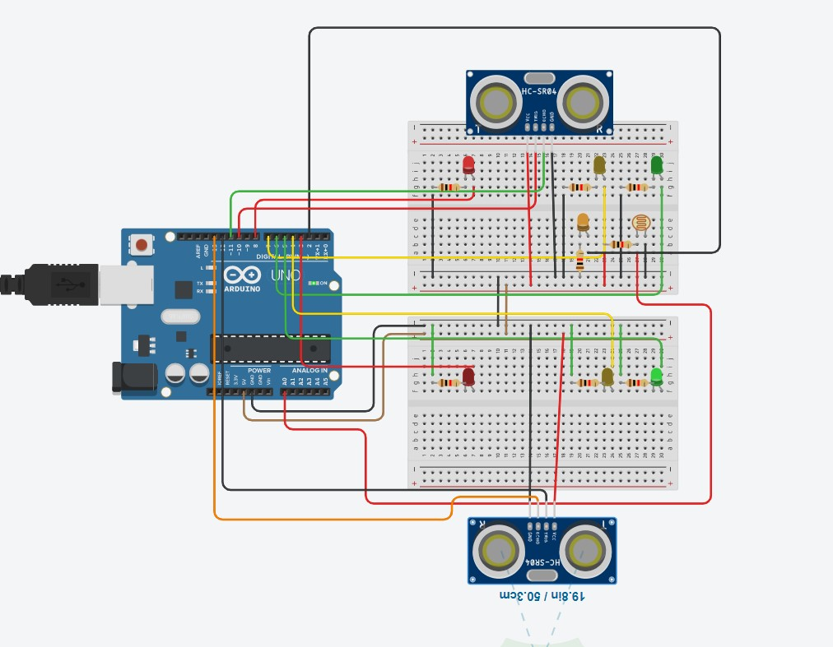
2) When D2<D1
Slide23
Dept. of EEE ASE, Bengaluru

Slide 24
APPLICATION:
Reduce human work using AI’s automation
No time wasted unnecessarily in the traffic signals
Disciplined and pacified traffic system
Systematic and free flowing vehicles with the rules followed up
Dept. of EEE ASE, Bengaluru
Slide24

Slide 25
POTENTIAL OF THIS PROJECT:
Could be incorporated with IR sensors to get a more accurate result
Speed trap guns could be added on the post to catch the over speeding or the vehicles on the wrong lanes
The sound recognizers could be added to the post which could turn the signal green to the emergency lifeline vehicles
We can add up HI-RES cameras to identify and track the vehicles by tracking them this could solve the crime
Dept. of EEE ASE, Bengaluru
Slide25

Slide 26
CONCLUSION:
Modern problem need modern solutions
Precise , consistent and efficient system
Reduce traffic tensions
Decreases the vulnerability of getting stuck in the accidents
Ensures a safe ride
Regulates rule breaks
Dept. of EEE ASE, Bengaluru
Slide26

Slide 27
REFERENCES:
[1] R.Bhargav Devi, E.Sravani,Gaddam Srujan, Shiv Shankar “Density Based Traffic Signal System using Arduino Uno” International Conference on Inventive Computing and Informatics (ICICI) 2017. [2] Zhang Yuye & Yan Weisheng, (2009) “Research of Traffic Signal Light Intelligent Control System Based On Microcontroller”, First International Workshop.
[2]Kaushik Mandal, Arindam Sen, Abhijnan Chakraborty and Siuli Roy “Road Traffic Congestion Monitoring & measurement using RFID & GSM Technology” , IEEE/Annual Conference on Intelligent Tranportation System, 2011
[3]https://ieeexplore.ieee.org/abstract/document/8365387
[4] https://www.semanticscholar.org/paper/Density-based-traffic-signal-system-using-Arduino-Devi-Reddy/c89e7e070b6ccee887418474de910b1b26c448bc
Dept. of EEE ASE, Bengaluru
Slide27

Slide 28
FOLLOW TO THE RULES AND RIDE SAFELY
THANK YOU
Dept. of EEE ASE, Bengaluru

